Slide 1
Microsoft Azure Service Fabric

Slide 2
Azure Service Fabric
Build, deploy, and operate applications, using any OS, at any scale, on any cloud
Build
Deploy
Operate
Build new or transform existing applications
Deploy any code at any scale using tools you know
Run and secure services reliably at any scale

Slide 3

Proven platform powering core Azure and Microsoft services
SQL Database
SQL
Power BI
{ }
Cosmos DB
Microsoft has deep expertise in running global services such as Corana, Skype & Cosmos DB
Service Fabric is the foundational technology powering these services & core Azure infra
Sample scale of one of these services: 60 billion events per day with millions of databases
About 30% of Azure’s cores run Service Fabric directly.
Dynamics
IoT Hub
Intune
Event Hub
Cortana
Skype

Slide 4










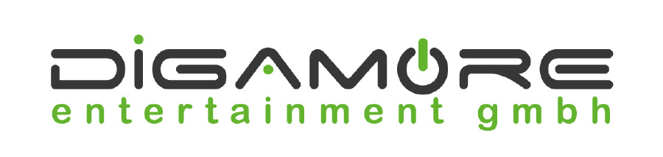





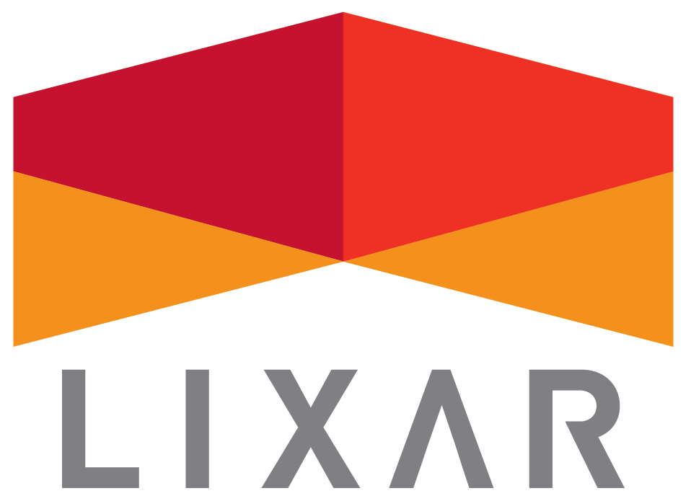



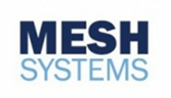


Trusted by customers of all sizes

Slide 5
Scenarios powered by Service Fabric
Empowering customers of all sizes to achieve more
Lift & shift to containers
Mission-critical business SaaS
IoT data processing
Low-latency data processing apps
New cloud-native apps
…one powerful Microservices platform for Windows Server and Linux containers

Slide 6




To monolith or to Microservice?
5 stages in a continuum…
1
2
3
4
5
Traditional app
Monolith Hosted as guest executable or container
Existing Monolith + new microservices
Parts of existing monolith extracted
New or transformed microservices app
... we support any stage you choose

Slide 7
To build, deploy, and operate…
…containers or microservices on any OS on any cloud
Programming Models
Dev & Ops Tooling
Orchestration
Lifecycle Management
Health &
Monitoring
Always On Availability
Auto
Scaling
Dev machine
Azure
On-premises infrastructure
Other clouds

Slide 8

Build: data-aware microservices
Programming Models
Dev & Ops Tooling
Orchestration
Lifecycle Management
Health &
Monitoring
Always On Availability
Auto
Scaling
Lifecycle Management
Always On Availability
Orchestration
Programming
Models
Health &
Monitoring
Dev & Ops
Tooling
Auto
Scaling
</>
Reliable Actors
Reliable Services
Guest Executables
Containers
.NET or Java …
Use familiar tools: Visual Studio + Team Services for .NET or Jenkins + Yeomen for Java
Manage state reliability without a database, lowering latency
Run existing code and orchestrate life cycle using service fabric
Orchestrate your Windows Server or Linux containers reliably at scale
Built-in ASP.NET core integration; work with VS and VSTS or Eclipse and Jenkins

Slide 9

Deploy: any code on any OS
Programming Models
Dev & Ops Tooling
Orchestration
Lifecycle Management
Health &
Monitoring
Always On Availability
Auto
Scaling
Lifecycle Management
Always On Availability
Orchestration
Programming
Models
Health &
Monitoring
Dev & Ops
Tooling
Auto
Scaling
CI/CD
Docker Compose
Automate
Rolling upgrades
Monitor and diagnose
Maximize uptime and scalability with isolated compute threads running concurrently
Orchestrate existing container applications natively
Deploy or remove applications using PowerShell, CLI, Visual Studio, and other APIs
Upgrade non-disruptively and roll-back in case of failures, automate with PowerShell
Generate, aggregate, and analyze events with built-in tooling and integration with Azure services

Slide 10
Operate: on any cloud at any scale
Programming Models
Dev & Ops Tooling
Orchestration
Lifecycle Management
Health &
Monitoring
Always On Availability
Auto
Scaling
Lifecycle Management
Always On Availability
Orchestration
Programming
Models
Health &
Monitoring
Dev & Ops
Tooling
Auto
Scaling
Use familiar tools
Use controlled chaos
Recover gracefully
Secure at scale
Scale programmatically
Such as Splunk, OMS, ELK, or AppInsights to gain deep insights or monitor application health
Test graceful and ungraceful failure scenarios
Recover from node or service failure gracefully; replicate data automatically
Secure node-to-node communication and user access using built-in capabilities
Use PowerShell, CLI, or APIs to scale programmatically achieving very high densities

Slide 11
Why they love Service Fabric

Slide 12

Awesome for developers
Use .NET, Java or more • Stateless and Stateful services • ASP.NET core integration
Open source programming models • Reliable services and actor programming model
Visual studio integration • Use single node cluster for dev/test purposes
Consistent experience across environments • Run the same environment on dev box as in production

Slide 13

Awesome for dev-ops
Automated deployment • Use PowerShell, Service Fabric CLI or APIs
Rolling upgrades for reliability • Upgrade your services in an automated fashion
Visual studio team services integration • For continuous integration and deployment
Integration with Jenkins and more • Use tools familiar to you for deploying Java applications

Slide 14

Awesome for infrastructure management
Cluster management • Secure your clusters and handle failures gracefully • Scale clusters programmatically or manually • Ease maintenance with integrated OS patching
PowerShell, CLI, and GUI management • Be productive and choose tools that suit your needs
Applications as an ARM resource • Manage clusters as well as deploy app using templates
Health monitoring • Monitor using integrated or 3rd party tool of your choice • Query health using PowerShell or APIs programmatically

Slide 15
Service Fabric’s Future

Slide 16
Recent Milestones…
In the last ~6 months:
GA of support for Windows Containers
GA of Service Fabric on Linux
GA of support for integration with Azure API Management
GA of support for Resource Governance
GA of support for DNS addressing within the cluster
Preview of support for .NET Core (Really .NET Standard 2)
Preview of full support for Java
Many performance, stability, and usability improvements

Slide 17

So what’s next?
Containers
Networking
Management
Simplification
API models inside
Volume drivers
Logs & Monitoring
Per-App network
Stable IPs
Resource Governance
Debugging Improvements
New APIs
Serverless/PaaS

Slide 18
Resources

Slide 19
Try it now: in under 5 minutes!
Create a new .NET Service Fabric application in Azure
https://docs.microsoft.com/en-us/azure/service-fabric/service-fabric-quickstart-dotnet
Deploy a Service Fabric Windows container application on Azure
https://docs.microsoft.com/en-us/azure/service-fabric/service-fabric-quickstart-containers
Deploy a Linux container application on Azure
https://docs.microsoft.com/en-us/azure/service-fabric/service-fabric-quickstart-containers-linux

Slide 20
More resources
Service Fabric developer SDK
http://aka.ms/ServiceFabricSDK
Service Fabric course and lab
https://mva.microsoft.com/en-US/training-courses/building-microservices-applications-on-azure-service-fabric-16747
Learn from samples, free clusters, and labs
http://aka.ms/ServiceFabricSamples
http://aka.ms/tryservicefabric
https://blogs.msdn.microsoft.com/azureservicefabric/2016/07/06/introduction-to-service-fabric-lab-part-1/
Questions? Comments? Issues?
https://stackoverflow.com/questions/tagged/azure-service-fabric
http://aka.ms/ServiceFabricForum
https://github.com/azure/service-fabric-issues
http://aka.ms/ServiceFabricSlack (request invite here)
Monthly Q&A – Announcements on the Team Blog here
Notes:
fa

Slide 21
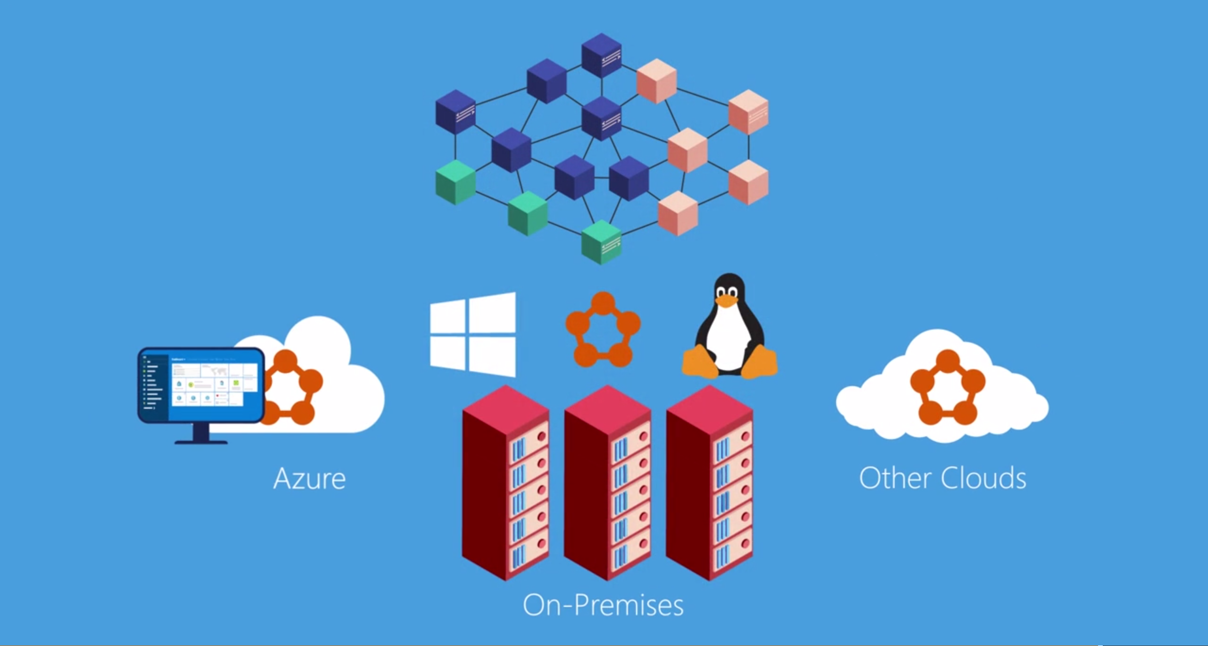

Service Fabric in under 4 minutes (video)

Slide 22
Thank you!

